Slide 1

CREDITGUARD (CreditGuard is an AI-powered credit card risk analysis system that predicts customer default risk using machine learning and advanced data analytics.)

Slide 2
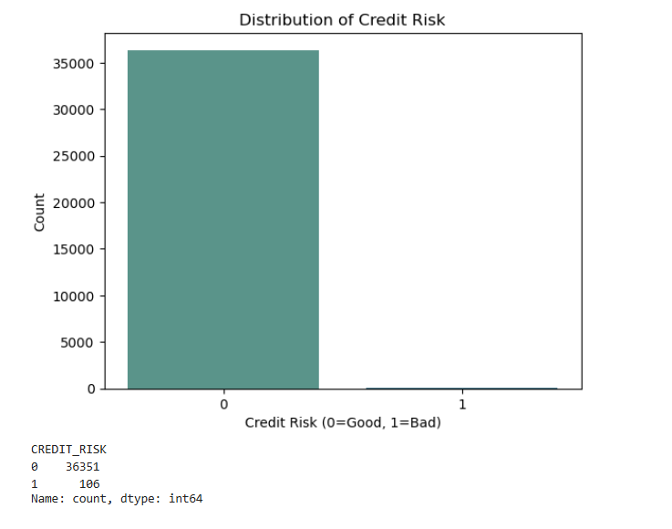
The CREDIT_RISK variable is highly imbalanced, with a significant majority of customers classified as Good Credit (0).
Out of 36,457 customers, 36,351 (99.71%) are classified as Good Credit, while only 106 (0.29%) are classified as Bad Credit.
The extremely small number of bad credit cases indicates that defaults are rare in this dataset.
This class imbalance may lead to biased machine learning models, as models can become biased toward predicting the majority class.
Special techniques such as SMOTE, oversampling, undersampling, or class weighting may be required during model training to handle the imbalance.
Evaluation metrics such as Precision, Recall, F1-score, and ROC-AUC should be preferred over accuracy alone when assessing model performance on this dataset.
FIG 1. Distribution of Credit Risk

Slide 3
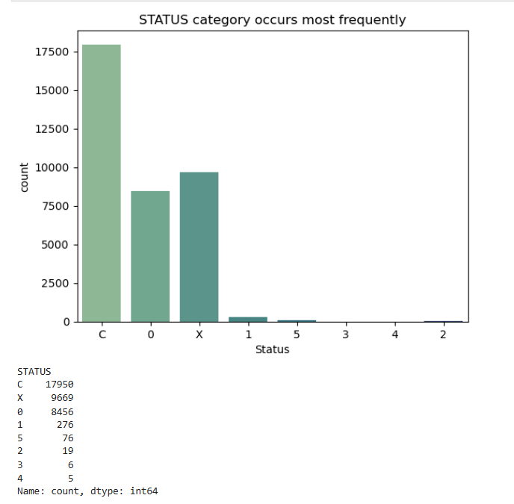
The most common repayment status is C (Loan Closed) with 17,950 customers (49.24%), followed by X (No Loan Activity) with 9,669 customers (26.52%).
8,456 customers (23.19%) have a status of 0 (Paid on Time), indicating regular and timely repayments.
Only 382 customers (1.05%) fall into the late payment or default categories (1–5), showing that delinquent repayments are uncommon.
The low frequency of severe delinquency (2–5) suggests that most customers have a stable repayment history.
The dominance of C, X, and 0 indicates that the dataset consists primarily of customers with low credit risk.
The scarcity of late payment statuses further supports the highly imbalanced distribution of the target variable (CREDIT_RISK), where bad credit cases are very rare.
FIG 2. Status category occurs most frequently

Slide 4
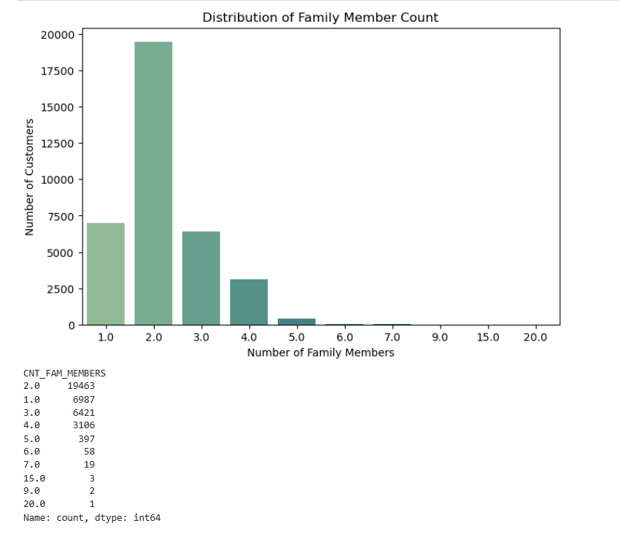
The majority of customers have 2 family members (19,463; 53.39%), making it the most common family size.
Customers with 1 and 3 family members are the next largest groups, indicating that small families dominate the dataset.
Family sizes of 4 or 5 members are less common but still reasonably represented.
Very few customers have more than 5 family members, suggesting that large families are rare.
A handful of records with 9, 15, and 20 family members may represent extreme values or potential outliers that warrant further investigation.
Overall, the distribution indicates that most customers belong to small or medium-sized households.
FIG 3. Distribution of Family Member Count

Slide 5
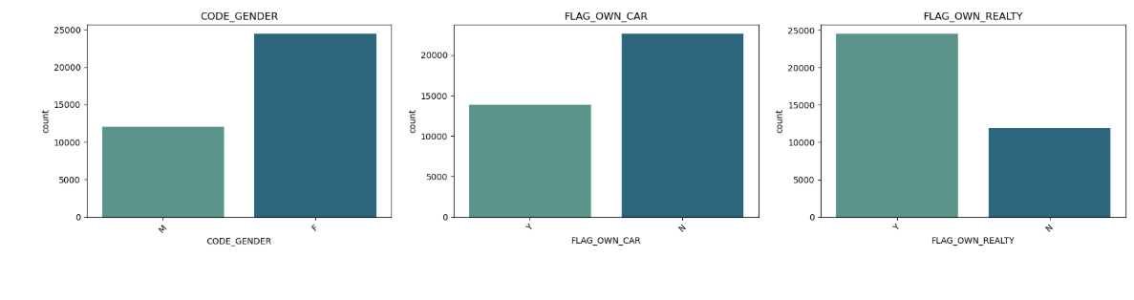
FIG 4. Value counts of Gender,Owning car,Owning real estate

Slide 6
The dataset contains more female customers than male customers, indicating that females constitute the majority of applicants.
A larger proportion of customers do not own a car (N) compared to those who own a car (Y).
Most customers own a house or property (Y), suggesting that property ownership is common among the applicants.
The higher percentage of property owners may indicate greater financial stability, which could positively influence creditworthiness.
Although car ownership is less common, property ownership is significantly higher, indicating that owning real estate is more prevalent than owning a car.
These demographic and asset ownership characteristics can be useful features for analyzing customer profiles and their relationship with credit risk.

Slide 7
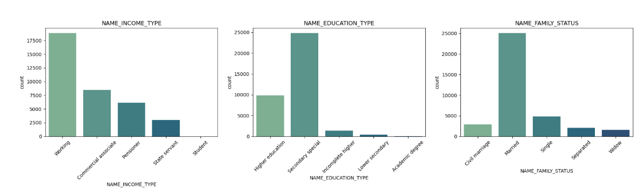
FIG 5. Value counts of Income type, Education type, Family Status

Slide 8
The majority of customers are Working, followed by Commercial Associates and Pensioners, while Students represent only a negligible proportion of the dataset.
Most customers have Secondary/Special Secondary Education, followed by Higher Education, indicating that the dataset primarily consists of customers with basic to intermediate educational qualifications.
Customers with Academic Degrees and Lower Secondary Education are very few compared to other education levels.
The majority of customers are Married, making it the most common family status in the dataset.
Single customers form the second-largest group, followed by Civil Marriage, Separated, and Widow categories.
The distributions suggest that the typical customer profile is a working, married individual with secondary-level education.
These demographic characteristics may influence customers' financial behavior and can be valuable predictors in credit risk analysis.

Slide 9
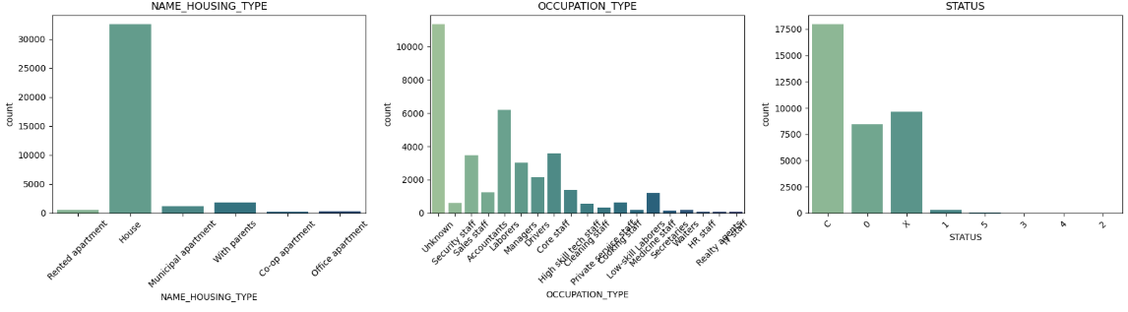
FIG 6. Value counts of Housing type,Occupation type, Status

Slide 10
The majority of customers live in their own house, while very few reside in rented apartments, office apartments, or co-op apartments.
A small proportion of customers live with their parents or in municipal apartments, indicating that independent home ownership is common.
The Unknown occupation category has the highest number of customers, followed by Laborers, Core Staff, and Sales Staff.
Occupations such as HR Staff, IT Staff, Secretaries, Realty Agents, and Waiters have relatively few customers in the dataset.
The C (Loan Closed) status is the most frequent repayment status, followed by X (No Loan Activity) and 0 (Paid on Time).
Very few customers fall into the late payment or default categories (1–5), indicating that serious repayment issues are uncommon.
Overall, the dataset consists mainly of homeowners with stable repayment histories, while severe credit delinquency is observed only in a small fraction of customers.

Slide 11
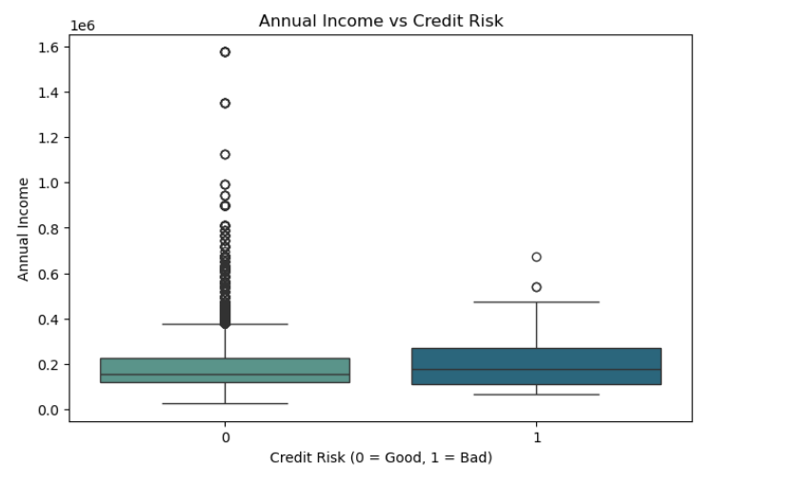
The median annual income of bad credit customers (1) is slightly higher than that of good credit customers (0).
The annual income distributions of both groups overlap considerably, suggesting that income alone does not clearly distinguish credit risk.
The good credit group (0) contains a large number of high-income outliers, indicating greater variability in income.
The bad credit group (1) has relatively fewer outliers, likely due to the small number of bad credit customers in the dataset.
Most customers in both credit risk groups have annual incomes within a similar range, with only a few earning exceptionally high incomes.
Overall, annual income does not appear to have a strong relationship with credit risk in this dataset, as both groups exhibit comparable income distributions.
FIG 7. Annual Income VS Credit Risk

Slide 12
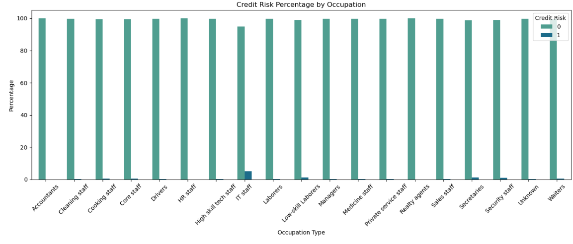
FIG 8. Credit Risk Percentage by Occupation

Slide 13
Across all occupation types, more than 98% of customers have good credit (Credit Risk = 0), indicating a generally low default rate.
Secretaries (1.32%), Low-skill Laborers (1.14%), and Security Staff (1.01%) have the highest proportions of bad credit customers among all occupations.
Occupations such as Accountants, HR Staff, and Realty Agents show 100% good credit, with no bad credit cases observed.
The IT Staff category has a relatively high bad credit rate (5%), but this result should be interpreted cautiously because it is likely based on a very small number of customers.
The Unknown occupation category also has a very high proportion of good credit customers (99.75%), similar to most other occupations.
Overall, occupation type alone does not appear to be a strong predictor of credit risk, as bad credit cases are extremely rare across all occupation categories.

Slide 14
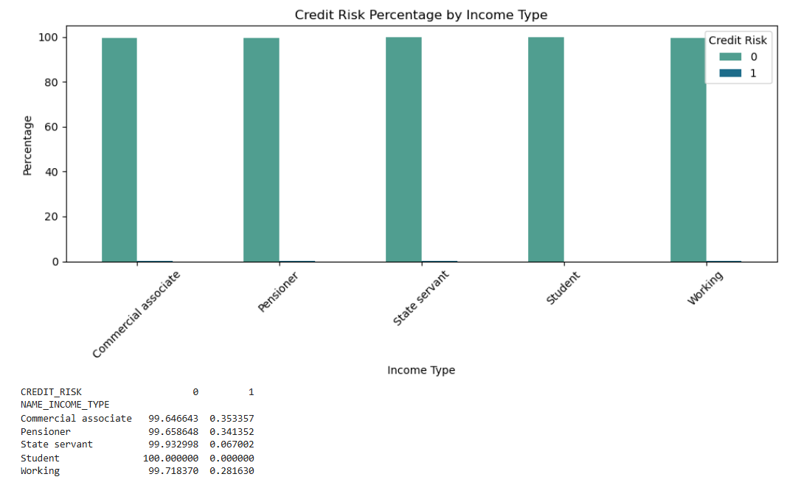
FIG 9. Credit Risk Percentage by Income Type

Slide 15
All income types have an exceptionally high proportion of good credit customers (above 99%), indicating a very low overall default rate.
Commercial Associates (0.35%) and Pensioners (0.34%) have the highest percentages of bad credit customers among the income groups.
Working customers also exhibit a very low bad credit rate (0.28%), suggesting stable repayment behavior.
State Servants have one of the lowest bad credit rates (0.07%), indicating excellent credit performance.
Students show 100% good credit, with no bad credit cases observed; however, this result may be due to the very small number of student records.
Overall, income type does not appear to have a strong influence on credit risk, as good credit customers dominate every income category.

